Slide 1
IntroductIon to BIoInformatIcs BLG 348E
Project Presentation
Kaan Karataş – 150200081
Alp Giray Kaçıra - 150170091

Slide 2
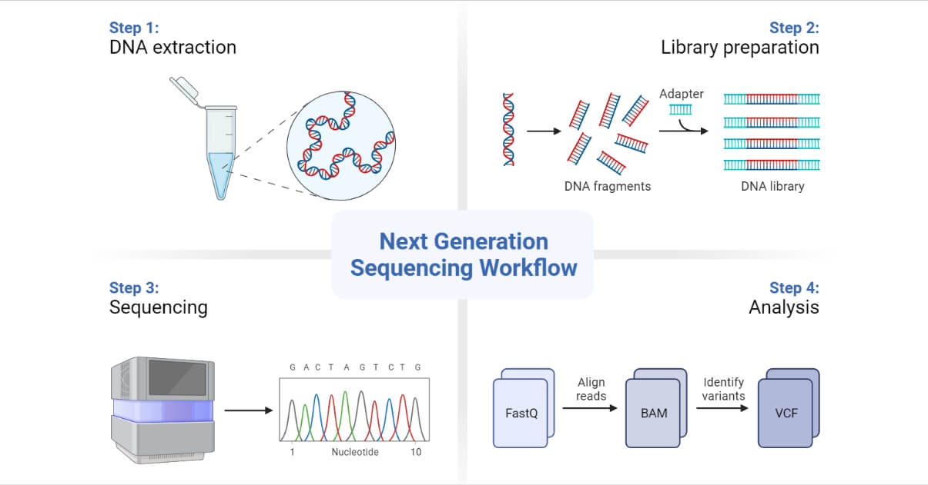
ngs

Slide 3
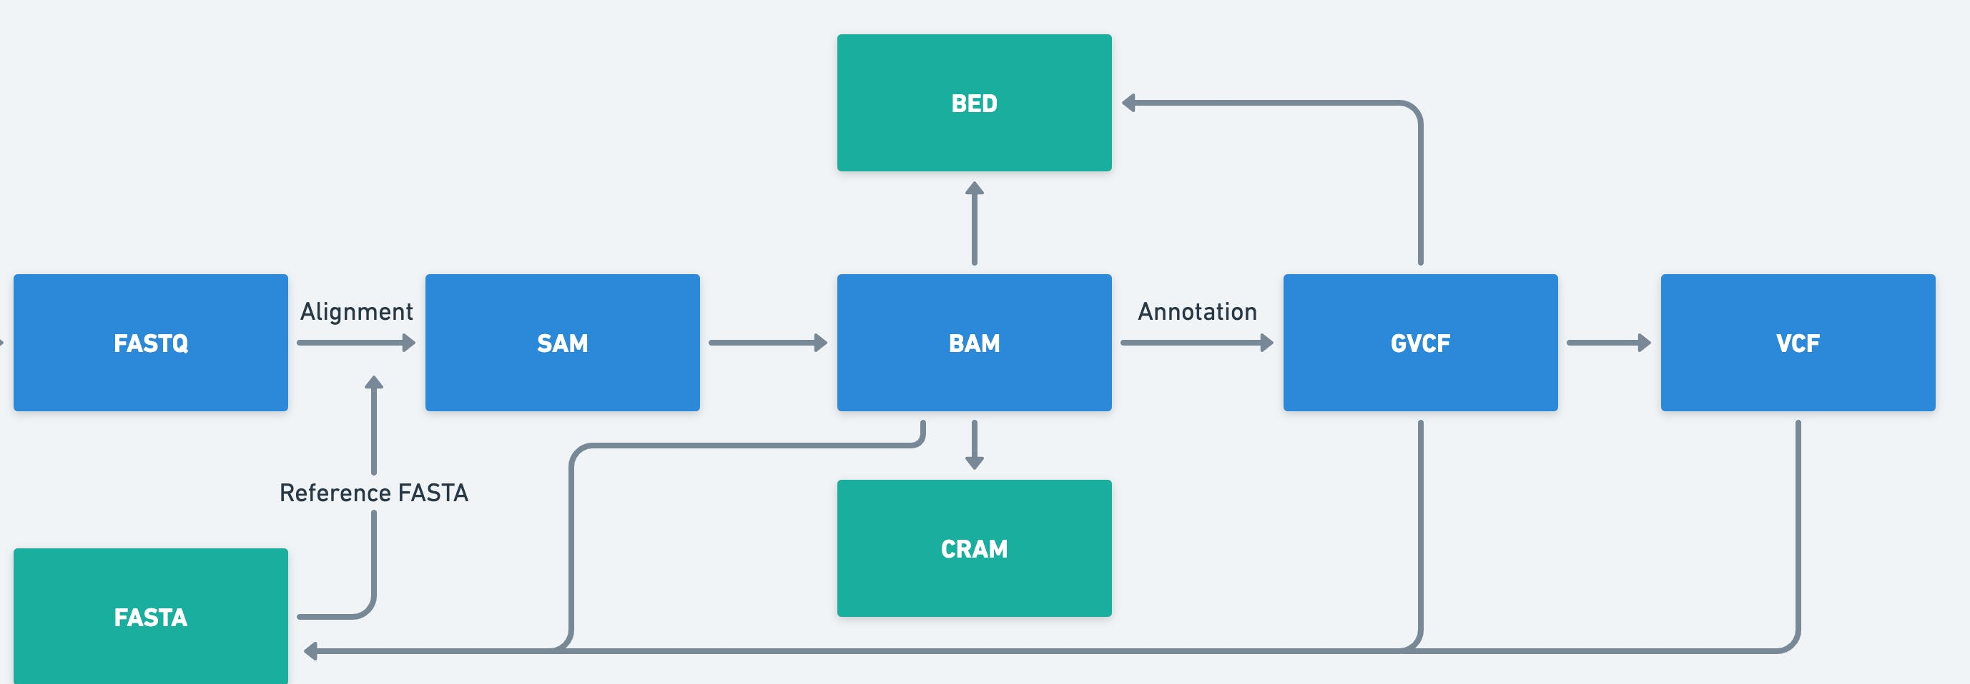
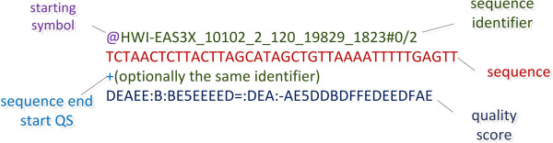
Cosap & fıle types

Slide 4
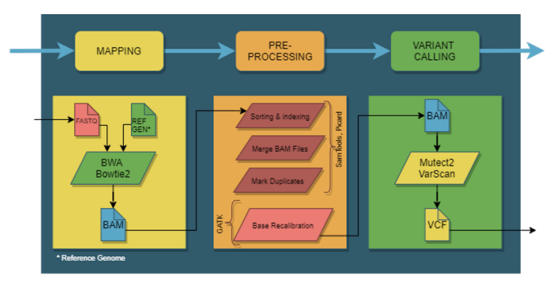
Pıpelıne structure

Slide 5
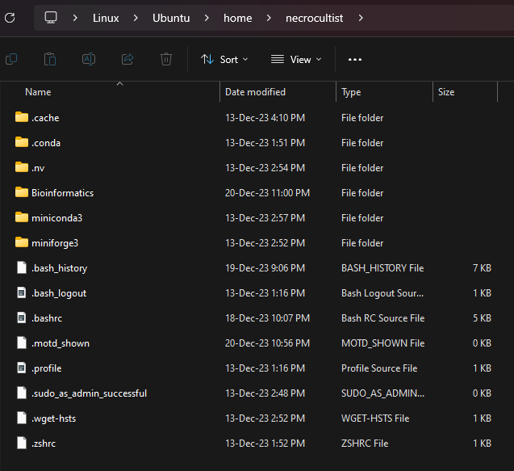
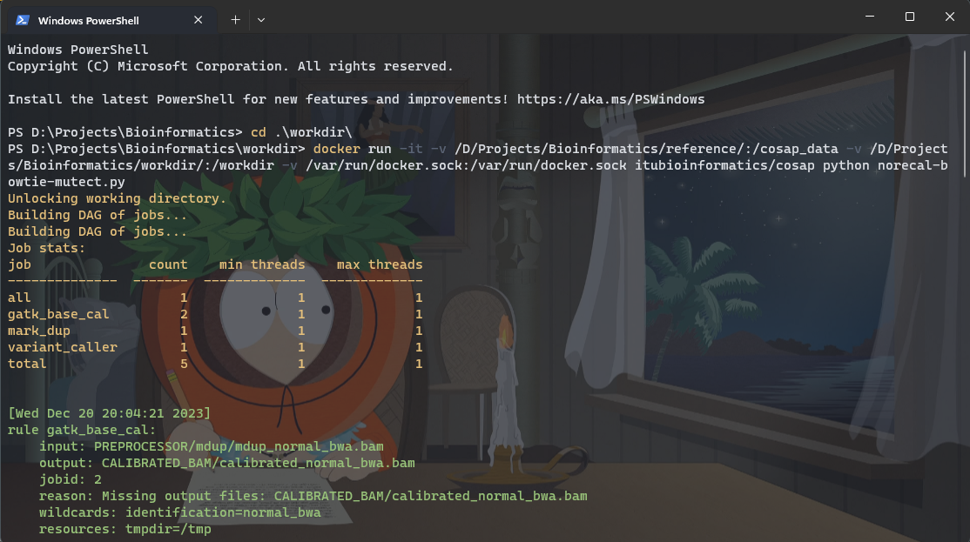
ınstallatıon

Slide 6
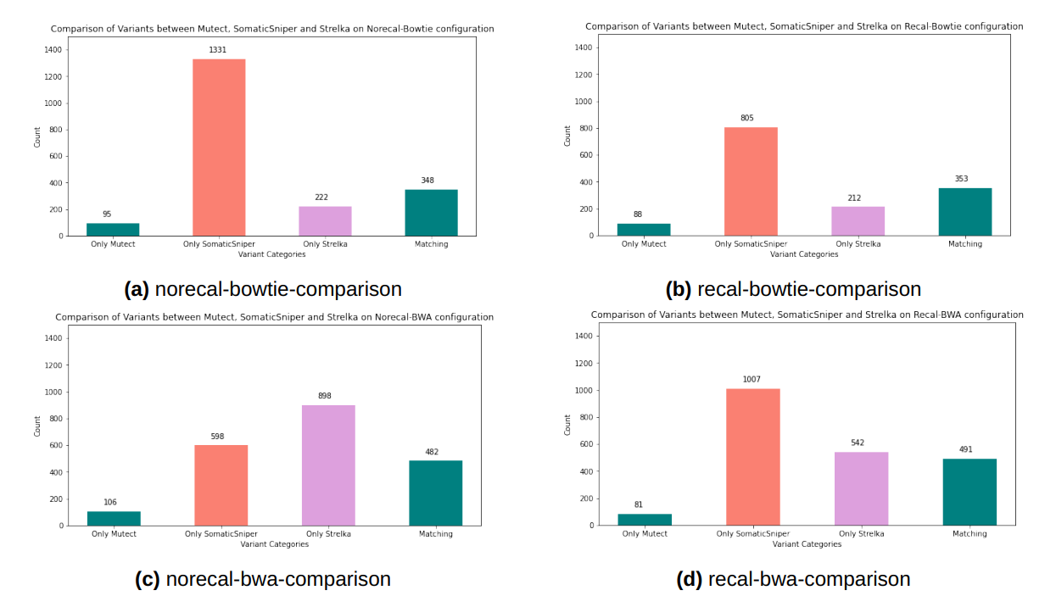
Varıant comparıson hıstograms

Slide 7
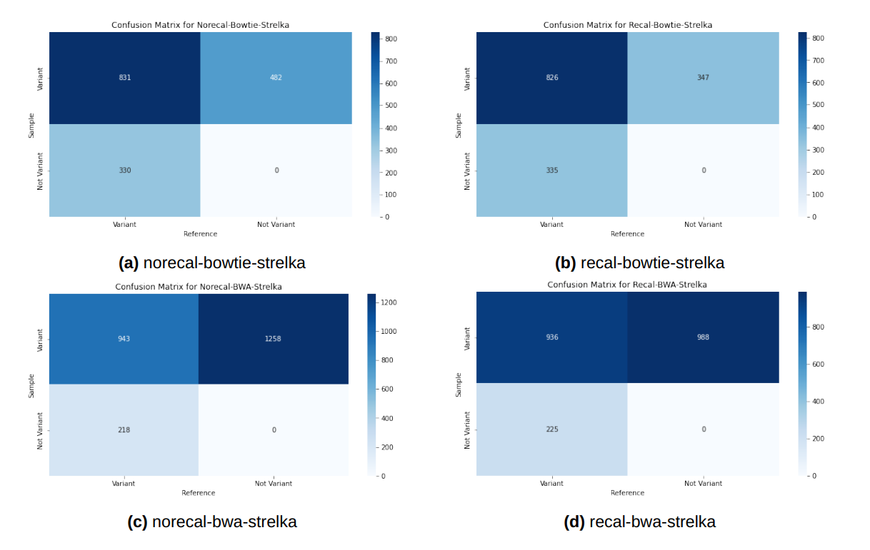
Confusıon matrıces

Slide 8
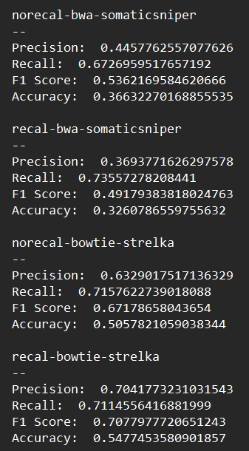
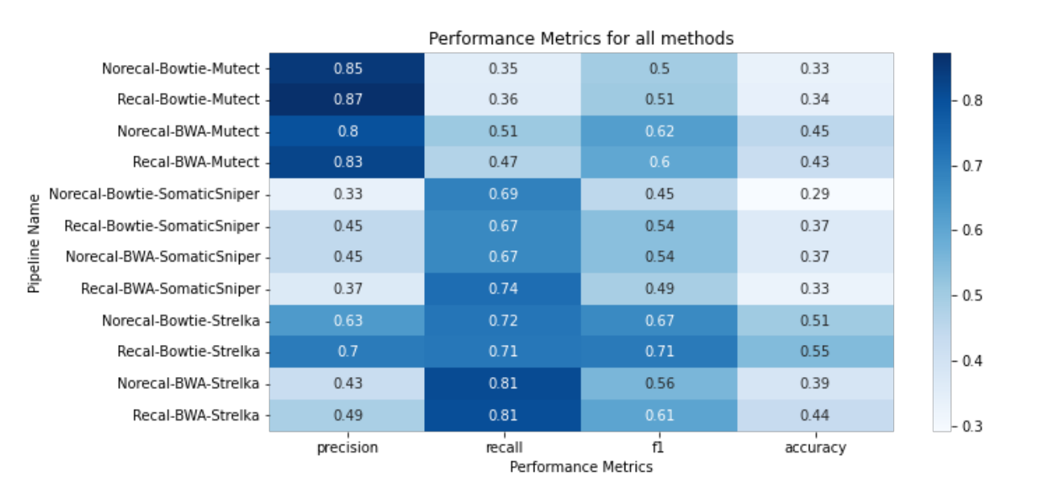
Precision, Recall, F1-Score, Accuracy && Performance Metrics

Slide 9
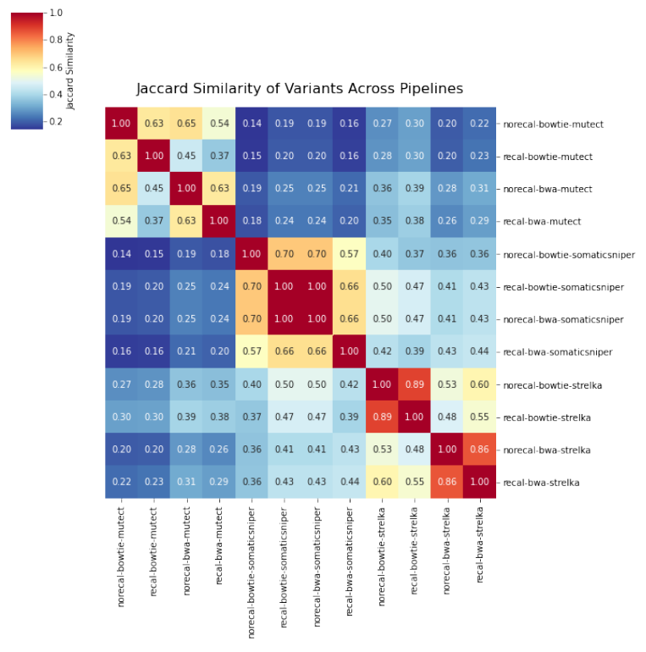
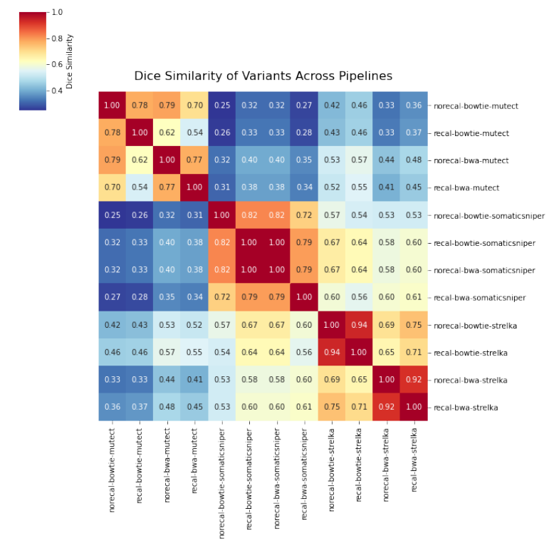
Heatmaps

Slide 10
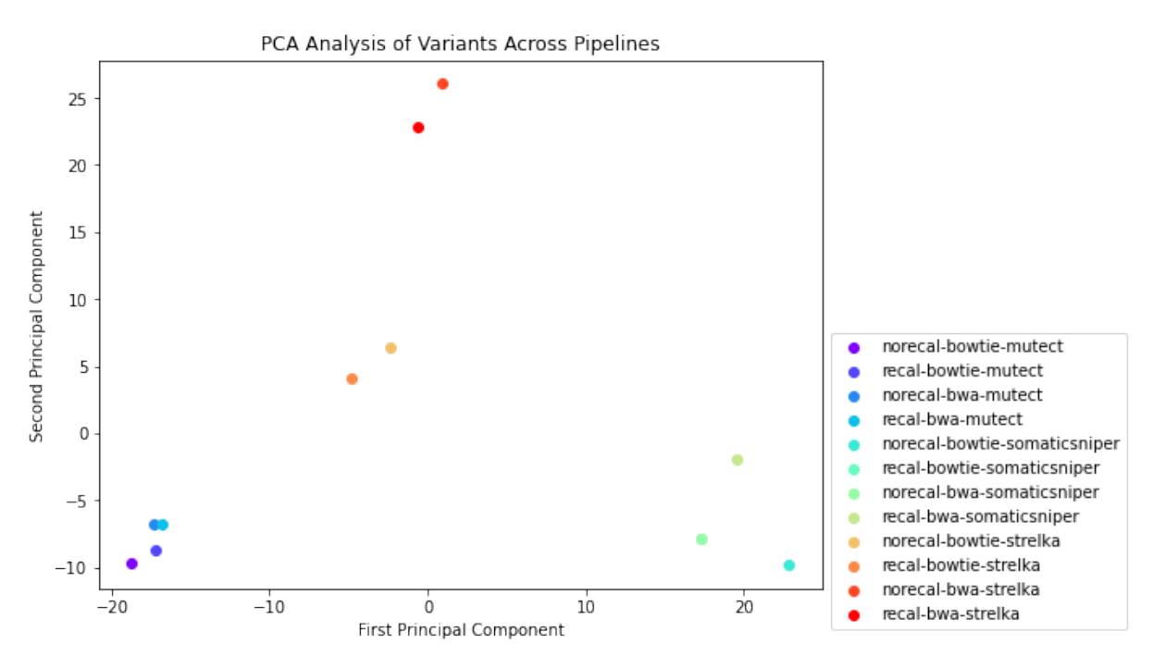
PCA

Slide 11
Thank you for lıstenıng

